Slide 1

B Y B L A Z E B U S T E R S
V E R S I O N 2 . 0
Showcase
Portfolio
D I V Y A R A J S I N H
S T E P H A N I E C U L L O M S A H I L G A Z U L A
A B H I P S A D A S S L I N H D A N G
2023/04/22

Slide 2



Overview
Motivation slide Entrepreneurship Ad Final design
Product Development Engineering Technology Product Specification Conclusion Recommendation

Slide 3

Motivation
HONESTY.
INTEGRITY.
CREATIVITY.
Increase the interest of students in STEM education.
To better the understanding of Arduino between adolescents.
To promote practical knowledge over theory-based knowledge in engineering.

Slide 4

Entrepreneurship Ad
B Y T H E B L A Z E B U S T E R S
( G R O U P 8 )

Slide 5

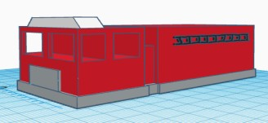
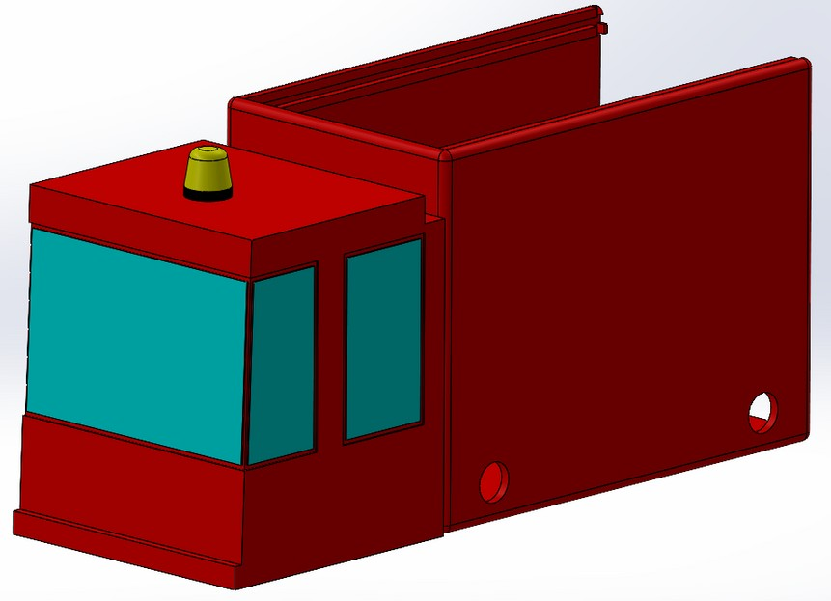
Initial vs Final Design
FINAL DESIGN
INITIAL DESIGN

Slide 6
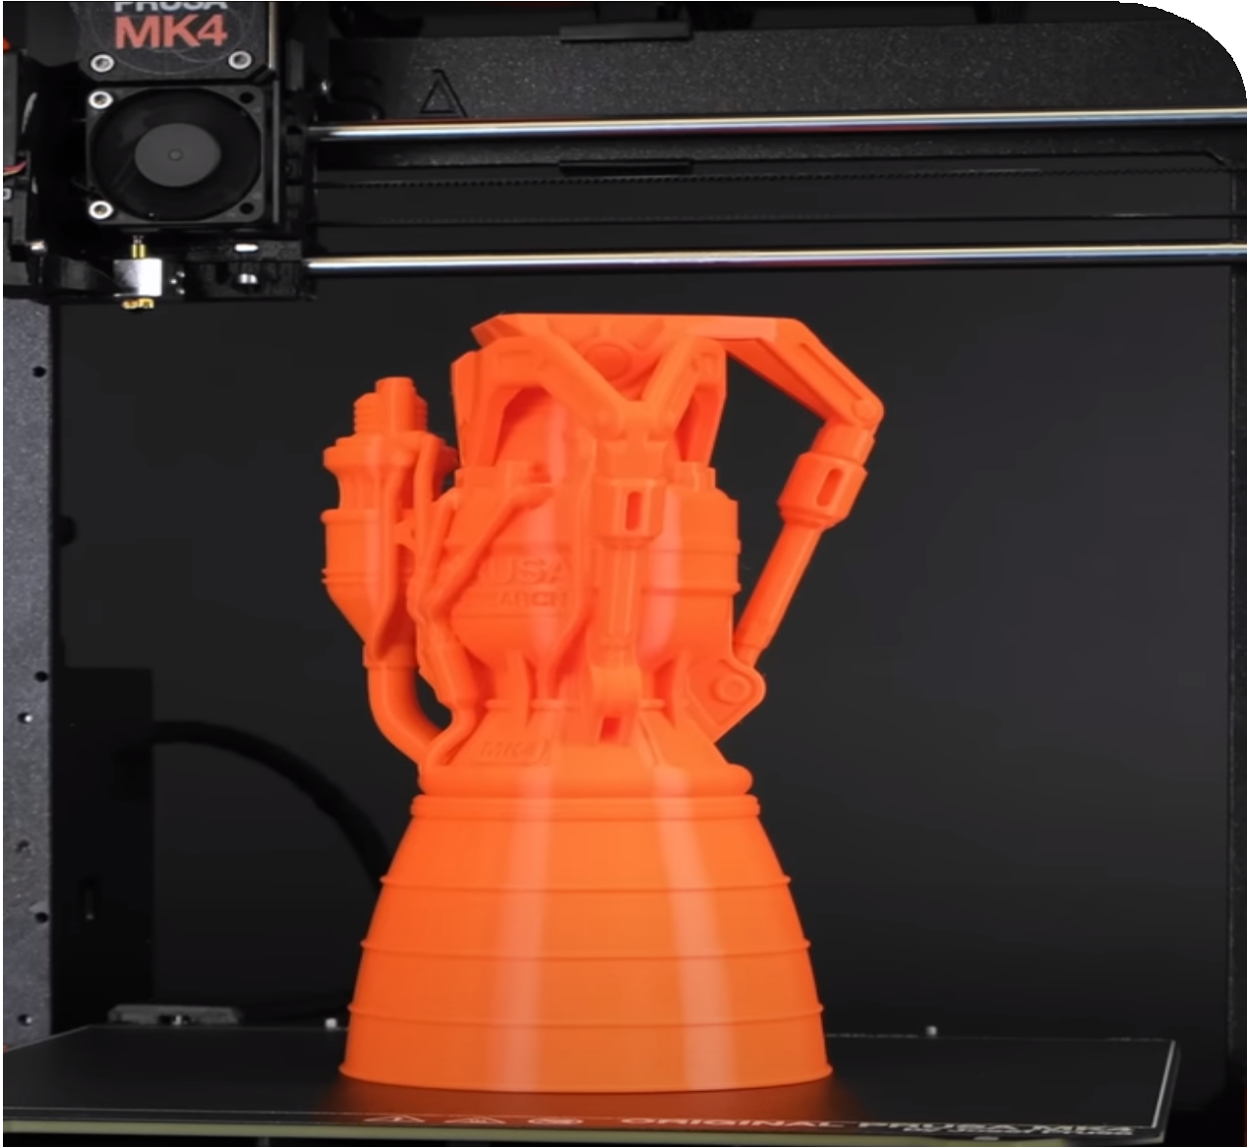
Product Development
01.
M A N U F A C T U R I N G
This step includes 3D printing the Chassis and modular faces.
B U S T E R S
( G R O U P 8 )
02.
W I R I N G
B L A Z E
This steps consists of following a schematic and connecting the appropriate sensors to their resepective input pins on the arduino.
T H E
B Y
03.
A E S T H E T I C E N H A N C E M E N T S
This step mainly involves painting the chassis and covering up any exposed wires, as best we can.
Images on next slide -->

Slide 7
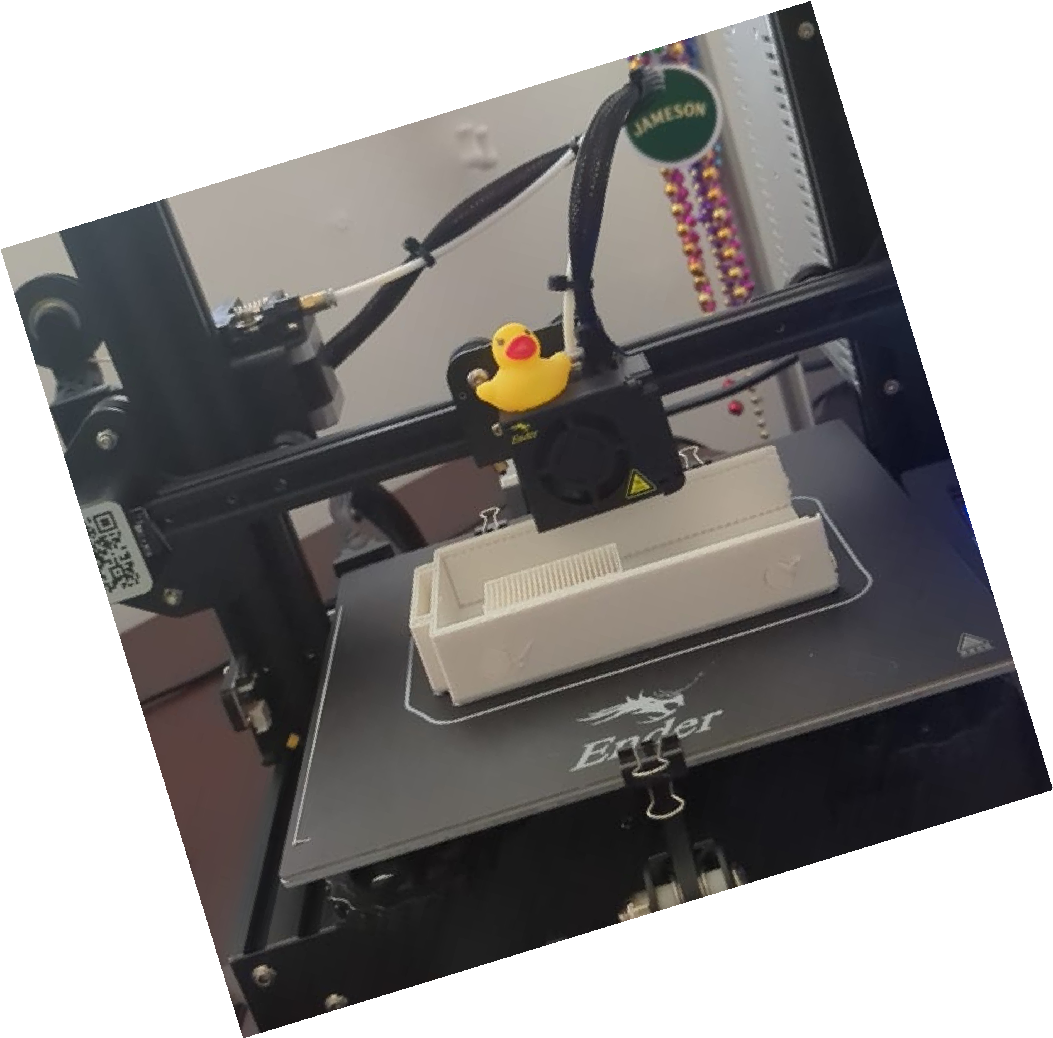
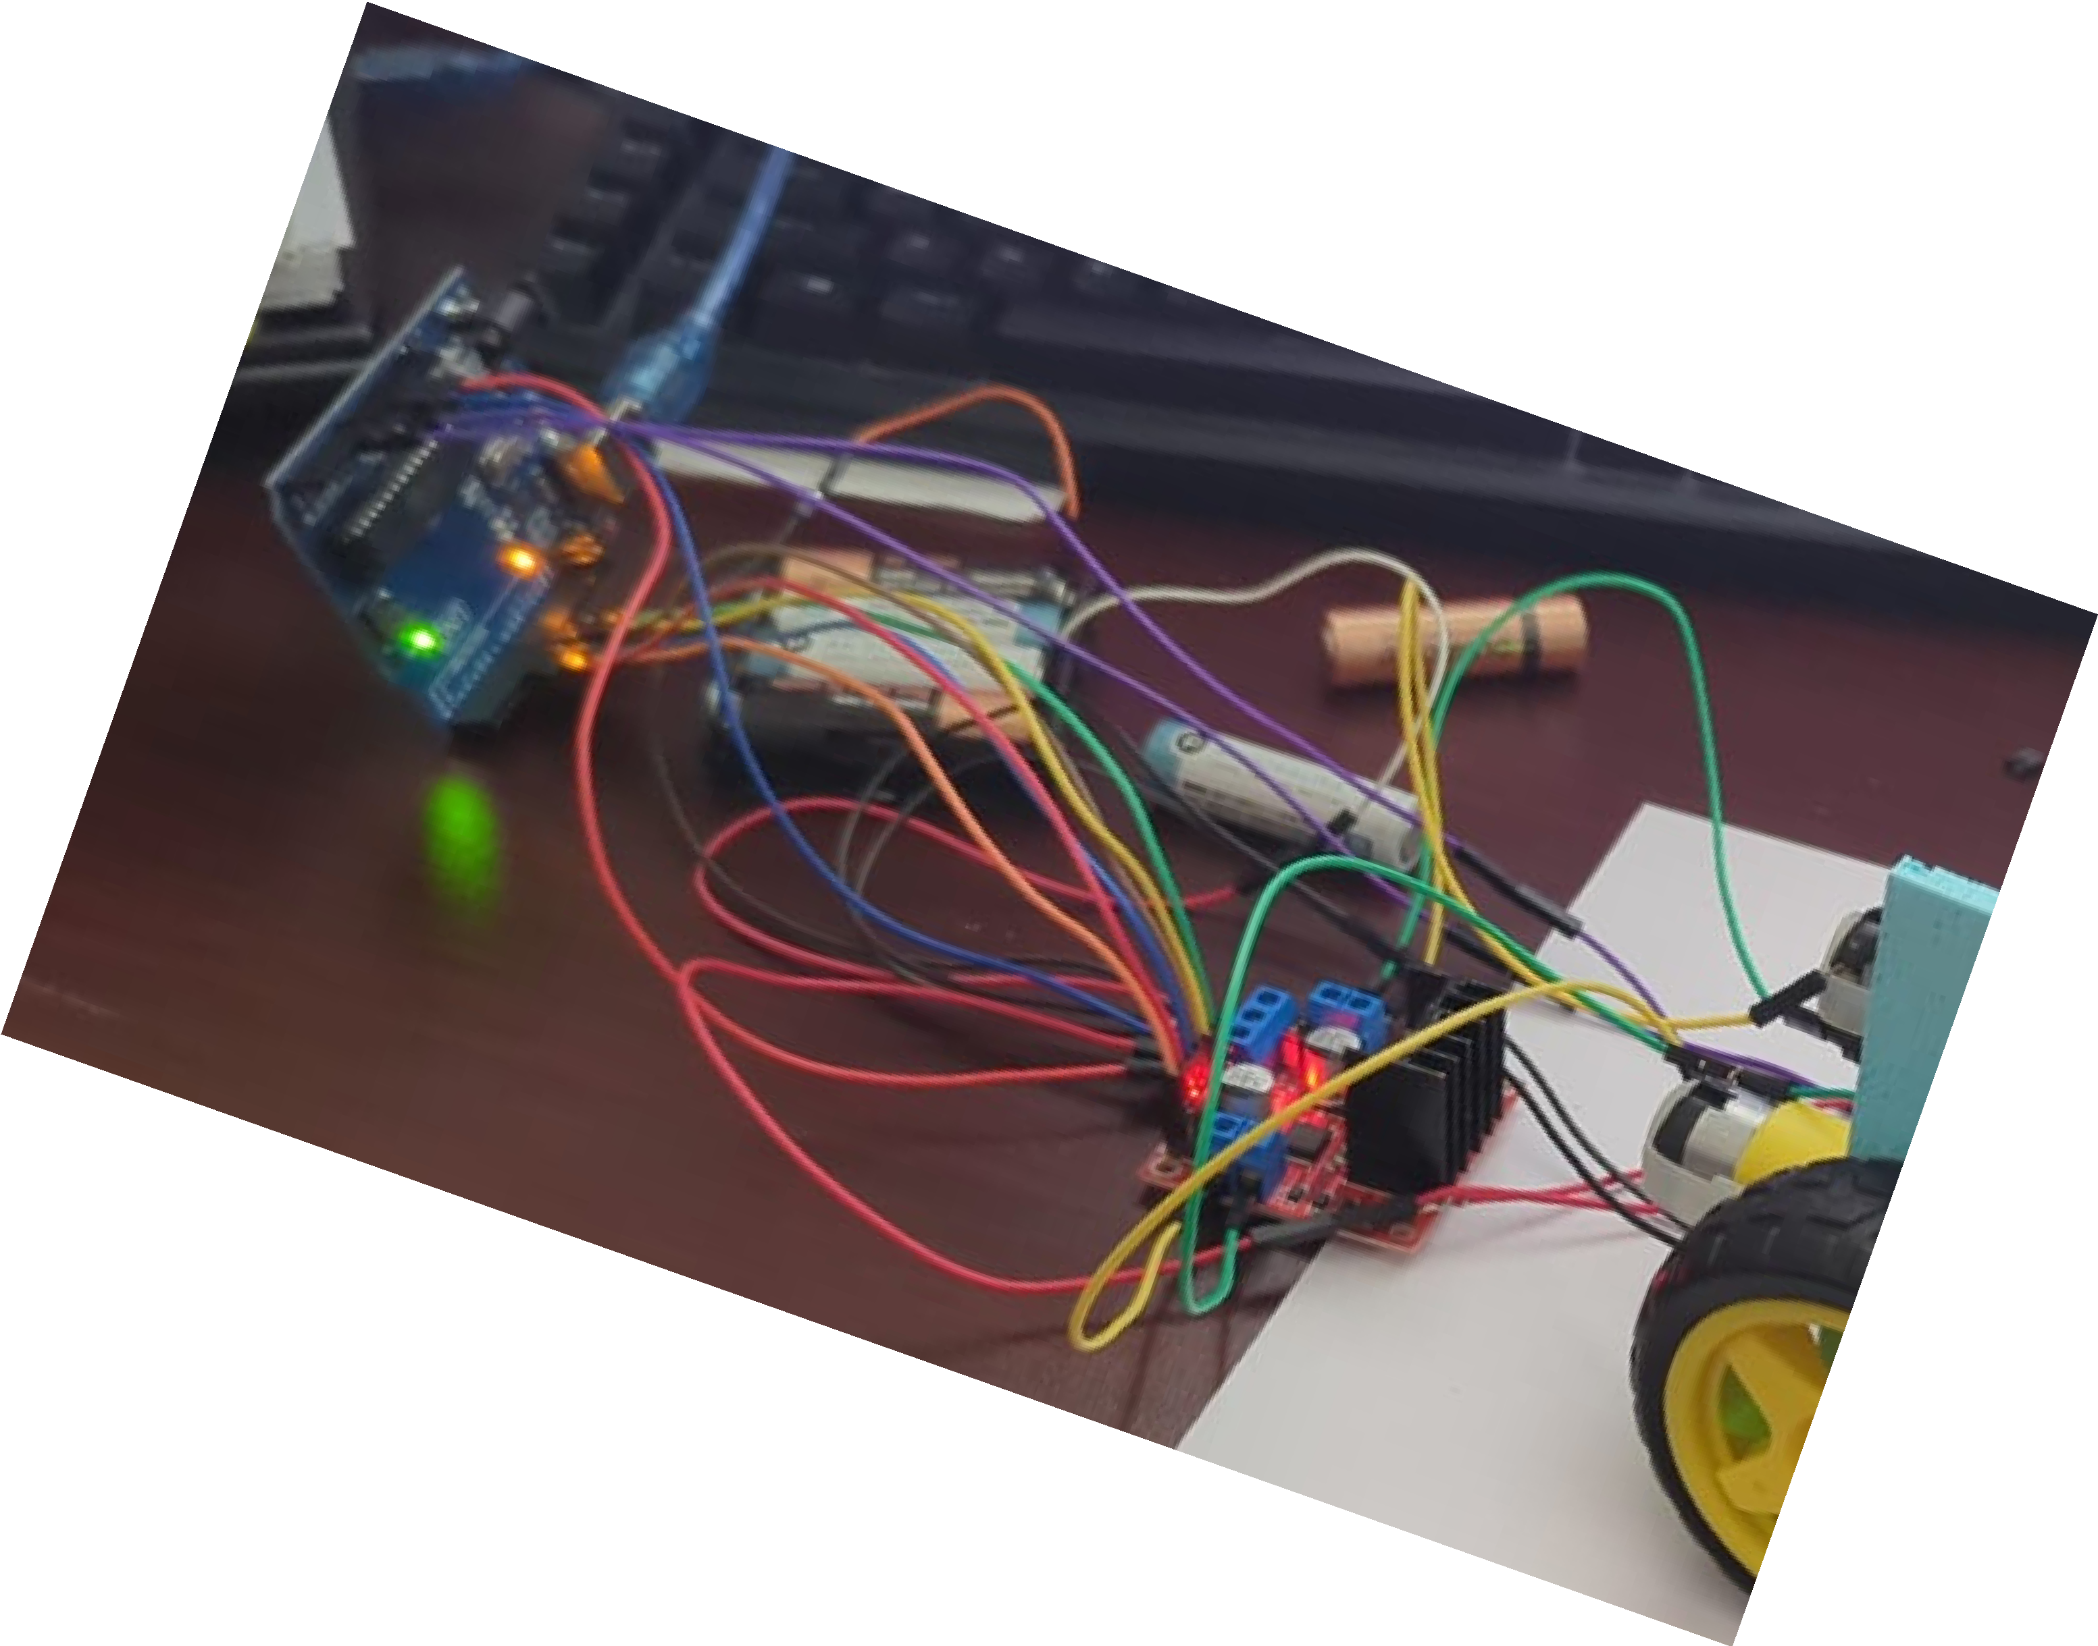
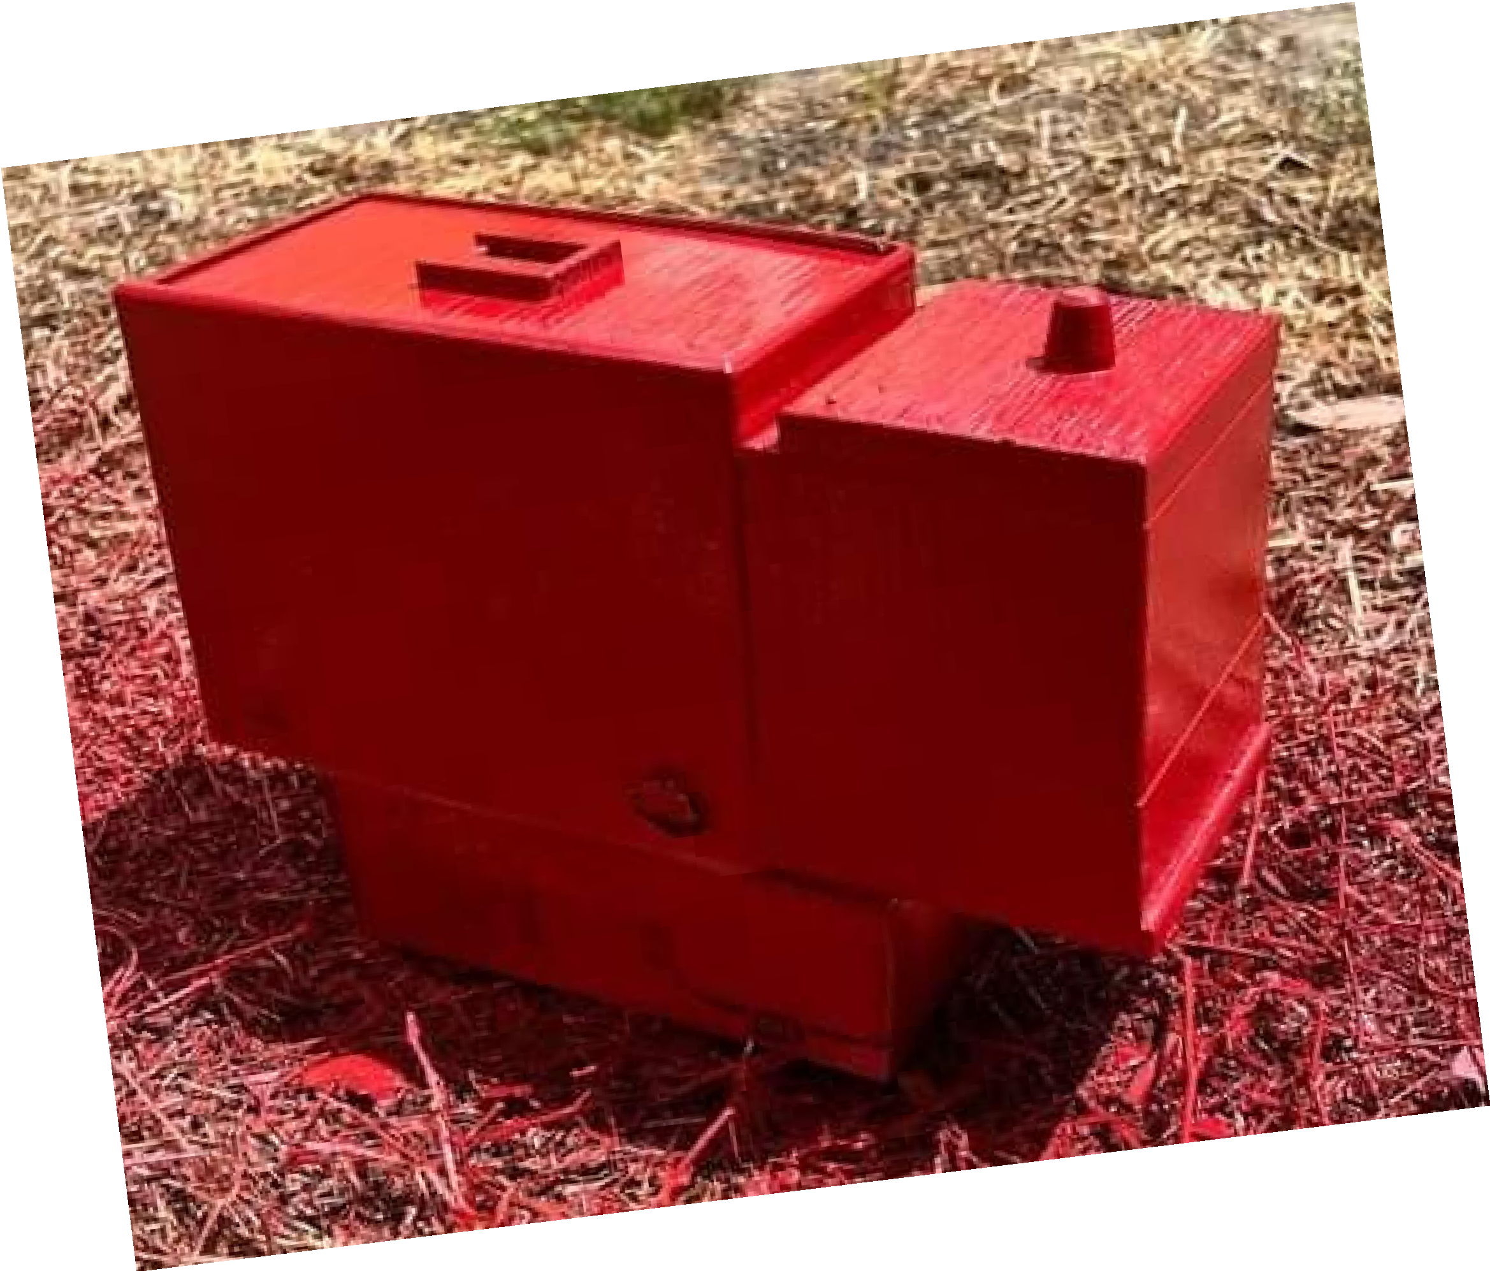
Wiring
Manufacturing
Aesthetics

Slide 8
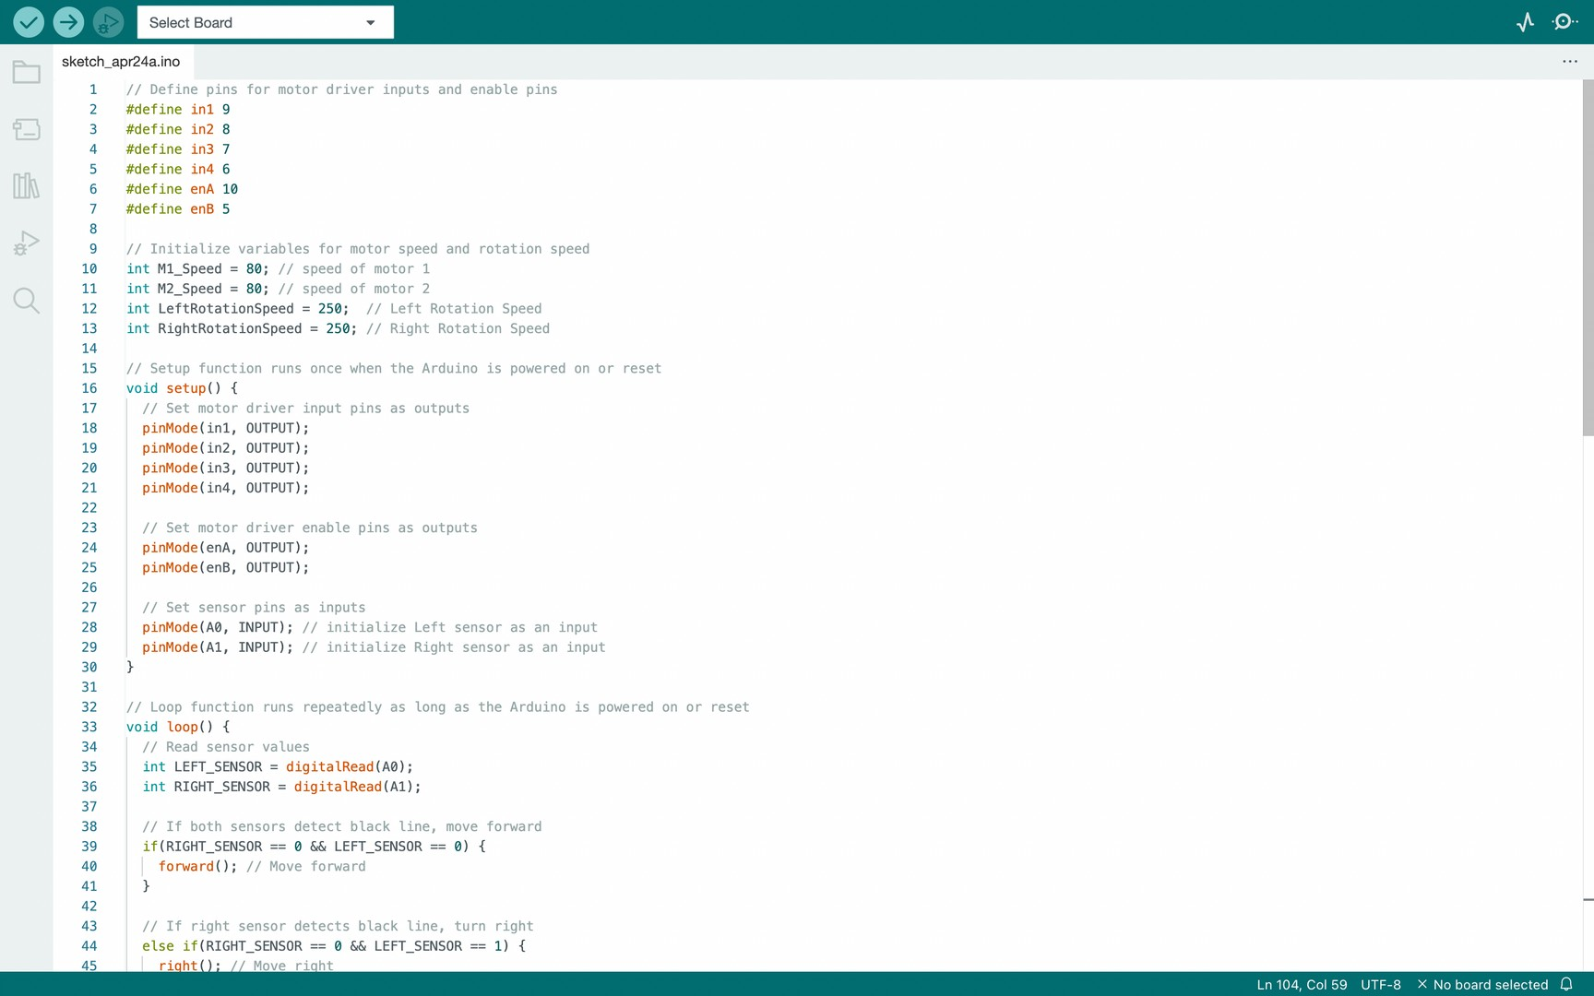
Engineering Technology

Slide 9
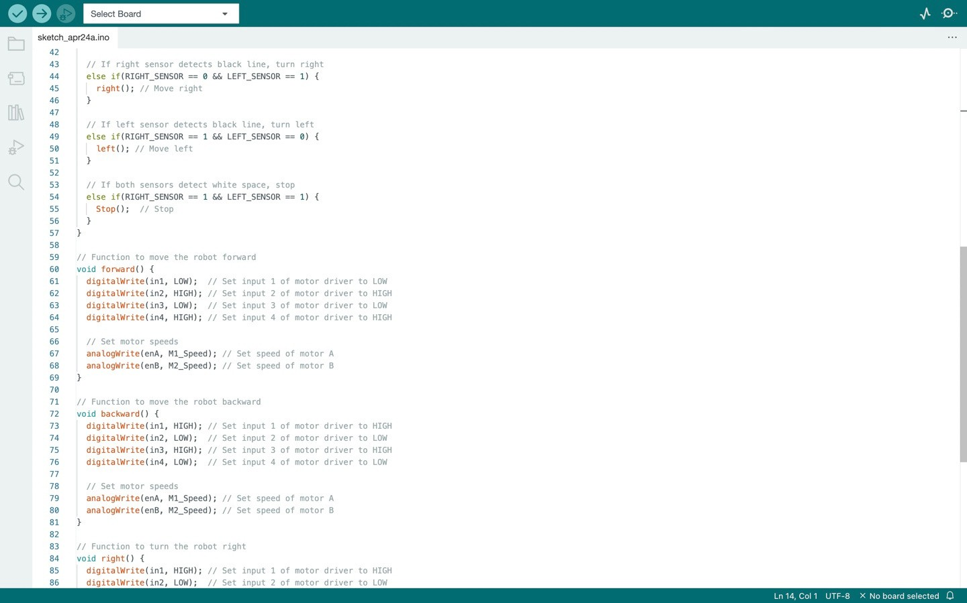
Engineering Technology

Slide 10
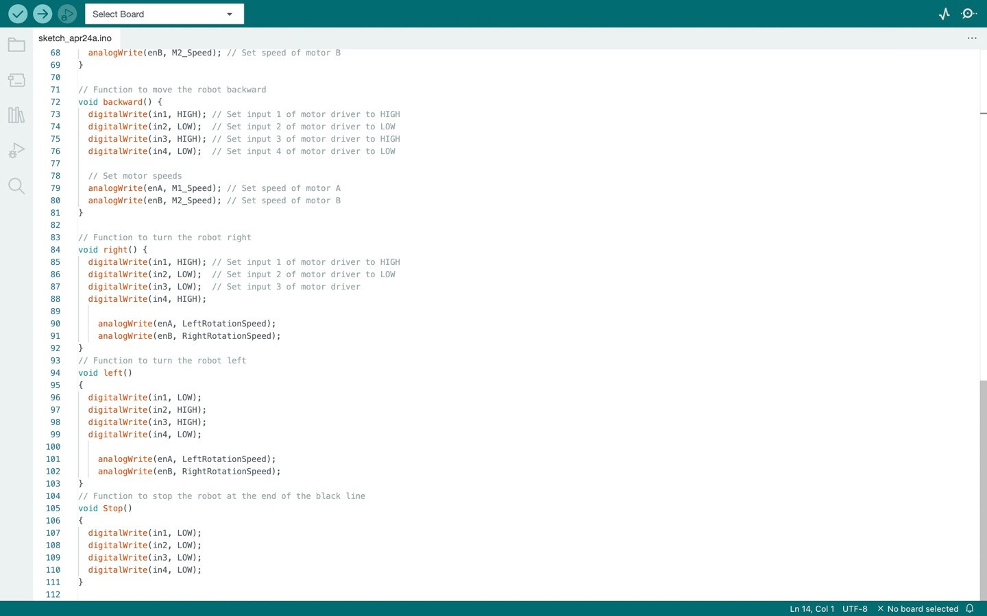
Engineering Technology

Slide 11
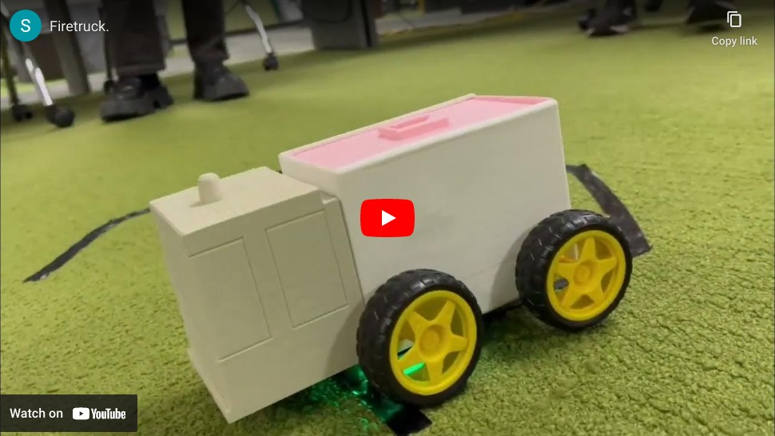
Engineering Technology
https://youtu.be/koAaD76Cvuo

Slide 12
Product Technology
VOLTAGE REQUIRED
SPEED
DIMENSIONS
ASSEMBLY TIME
OPERATIONAL DISTANCE
9v
5cm/s
approximately 1 minute
100 cm
8''x6''x4''

Slide 13

C O N C L U S I O N
WE, THE BLAZE BUSTERS LEARNT HOW TO CREATE, TEST AND ADVERTIZE A BOT.
GAINED ENGINEERING AS WELL AS ENTREPRENEURIAL EXPERIENCE.
LEARNED HOW TO WORK EFFICIENTLY IN A GROUP WITHIN A GIVEN TIME FRAME.
04

Slide 14

Recommendations
-A bit more accuracy during the 3-D printing process.
-Rechargeable batteries.
-More design additions.
14

Slide 15
THANK YOU!
BY THE BLAZE BUSTERS

